Slide 1
Agile Software Engineering
Background and overview

Slide 2
Introduction
Why software methodologies matter

Slide 3
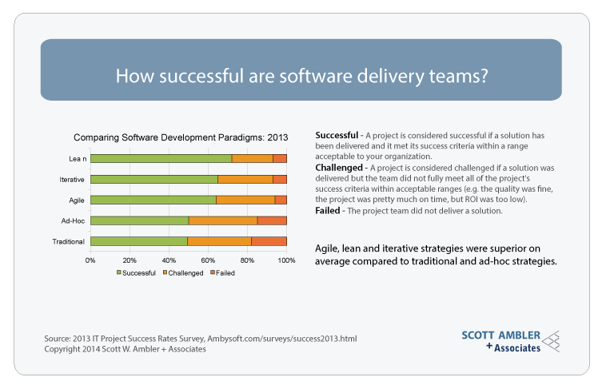

Slide 4
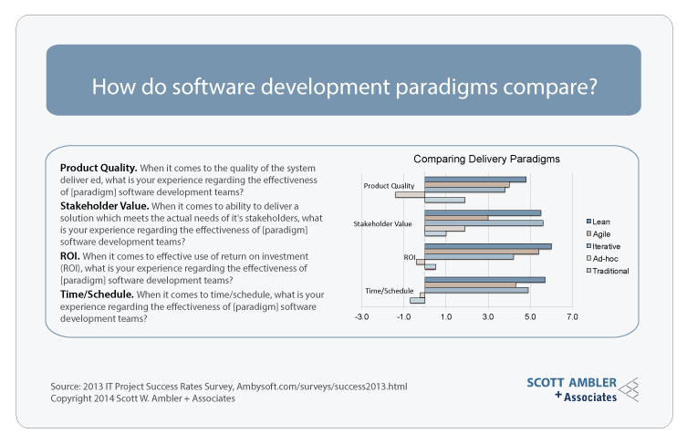

Slide 5
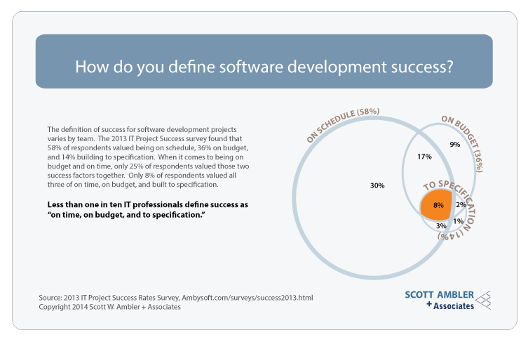

Slide 6
Iterative Software Engineering

Slide 7
Definition
Iterative development is an approach to building software (or anything) in which the overall lifecycle is composed of several iterations in sequence.
Each iteration is a self-contained mini-project composed of activities such as requirements analysis, design, programming, and test.
The goal for the end of an iteration is an iteration release, a stable, integrated and tested partially complete system.

Slide 8
Incremental Development
Although an iteration can in theory be only for clean-up or performance tuning, usually the partial system grows incrementally with new features, iteration by iteration – incremental development.
Each iteration includes production-quality programming (subset of the final system)
Most projects have at least three iterations before a final public release

Slide 9
What To Do: Risk-Driven Approach
Risk-driven iterative development chooses the riskiest, most difficult elements for the early iterations.
Risk-driven iterative development chooses the riskiest, most difficult elements for the early iterations

Slide 10
What To Do: Client-Driven Approach
Client-driven iterative development implies that the choice of features for the next iteration comes from the client—whatever they perceive as the highest business value to them.
Client steers the project, iteration by iteration, requesting the features that they currently think are most valuable
Client adaptively plans the choice for the next iteration, shortly before it starts

Slide 11
Mix Both Approaches
Clients do not always appreciate what is technically hard or risky. Developers do not always appreciate what has high business value.

Slide 12
Timeboxed Iterative Development
Iteration timeboxing is the practice of fixing the iteration end date and not allowing it to change.
Rather than slip the iteration end date, the scope is reduced
Most methods recommend an iteration timebox between one and six weeks
Not all timebox lengths need be equal
Scrum recommends that each timebox be exactly 30 calendar days

Slide 13
Stability
Once the requests for an iteration have been chosen and it is underway, no external stakeholders may change the work.

Slide 14
Evolutionary Development
Evolutionary iterative development implies that the requirements, plan, estimates, and solution evolve or are refined over the course of the iterations, rather than fully defined and "frozen" in a major up-front specification effort before the development iterations begin.

Slide 15
Adaptive Development
Adaptive development implies that elements adapt in response to feedback from prior work—feedback from users, tests, developers, and so on.
Adaptive planning is encouraged rather than predictive planning:

Slide 16
Agile Software Development
Agile development methods apply
timeboxed
iterative & evolutionary development,
adaptive planning,
evolutionary delivery,
and include other values and practices that encourage agility — rapid and flexible response to change.

Slide 17
Introduction to Lean Software Development
Origins of Lean Thinking

Slide 18




Origin
vs.

Slide 19
Corporate Goal
Respect for People
Continuous Improvement
Product Development
14 Principles
Corporate Management Culture

Slide 20
Corporate Goal
Corporate Goal
Respect for People
Product Development
Continuous Improvement
14 Principles
Sustainable shortest lead time
Best quality and value
Lowest cost
High morale
Safety
Corporate Management Culture

Slide 21
Corporate Mgmt. Culture
Corporate Goal
Respect for People
Product Development
Continuous Improvement
14 Principles
Managers as mentors/coaches
Managers grown from within
Managers as experienced engineers: “my manager can do my work better than me”
Corporate Management Culture
 | Work expert | General manager
Top-down | Task Master: “Here is what and how to do: do it!” | Bureaucrat: “Follow the rules!”
Bottom-up | Coach/Mentor: “Here is what we need to reach: I will guide and coach” | Facilitator: “You are empowered!”
Toyota leaders

Slide 22
Respect for People
Corporate Goal
Respect for People
Product Development
Continuous Improvement
14 Principles
Don’t trouble people (with waiting, defects, overload, wasteful work)
Invest in people development (for both engineering and problem solving)
Let people evolve own practices & improvements
Develop teams
Build partners
Corporate Management Culture

Slide 23
Continuous Improvement
Corporate Goal
Respect for People
Product Development
Continuous Improvement
14 Principles
Go See
Kaizen
Perfection challenge
Corporate Management Culture
Wastes
Overproduction
Waiting
Extra processes
Partially done work
Task switching
Defects
Handoff, movements
Sources of wastes
NVA activities
Overburden
Variability

Slide 24
14 Principles
Corporate Goal
Respect for People
Product Development
Continuous Improvement
Long-term philosophy
Move toward flow
Pull systems, decide as late as possible
Work leveling
Stop-n-Fix
Master norms
Simple visual mgmt. (aka Kanban)
Well-tested technology
Leaders from within
People development
Respect for partners
Go See
Decide slowly, implement rapidly
Kaizen
14 Principles
Corporate Management Culture

Slide 25
Lean Product Development
Corporate Goal
Respect for People
Product Development
Continuous Improvement
14 Principles
Skilled engineers
Amplified learning and knowledge sharing
Timeboxing
Set-based concurrent engineering
Entrepreneurial engineering chief
Corporate Management Culture
“Outlearn the competition”

